Slide 1
UNIT III DC MACHINES
Prepared
by
K.Lavanya

Slide 2
What is a DC Machine?
A DC machine is an electromechanical device that is used to convert electrical energy into mechanical energy or vice versa.
The DC machine used to convert electrical energy into mechanical energy, which is known as DC motor and the DC machine used to convert mechanical energy into electrical energy, which is known as DC generator.
The same machine can be used either as a motor or generator. The construction is same for DC motor and DC generator.
The DC machine can be classified into two types namely DC motors as well as DC generators.
Most of the DC machines are equivalent to AC machines because they include AC currents as well as AC voltages in them.
The output of the DC machine is DC output because they convert AC voltage to DC voltage. The conversion of this mechanism is known as the commutator, thus these machines are also named as commutating machines.
DC machine is most frequently used for a motor.
The main benefits of this machine include torque regulation as well as easy speed.

Slide 3
The applications of the DC machine is limited to trains, mills, and mines. For example, underground subway cars, as well as trolleys, may utilize DC motors.
In the past, automobiles were designed with DC dynamos for charging their batteries.

Slide 4
There are two types of generators–DC generators and AC generators. Both DC and AC generators convert mechanical power to electrical power. A DC generator produces direct power, while an AC generator produces alternating power.
Both of these generators produce electrical power based on the principle of Faraday’s law of electromagnetic induction.
This law states that when a conductor moves in a magnetic field it cuts magnetic lines of force, which induces an electromagnetic force (EMF) in the conductor.
The magnitude of this induced EMF depends upon the rate of change of flux (magnetic line force) linkage with the conductor. This EMF will cause a current to flow if the conductor circuit is closed.
Hence the most basic two essential parts of a generator are:
The magnetic field
Conductors which move inside that magnetic field.

Slide 5
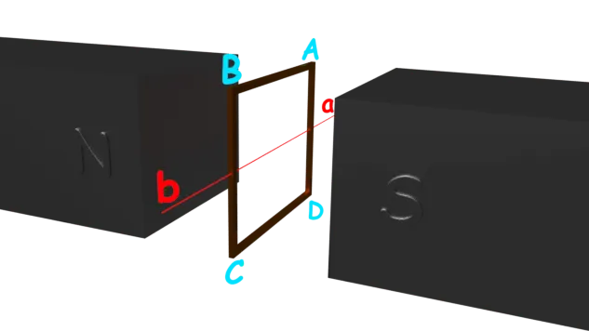
The Working Principle Of A DC Generator.
Single Loop DC Generator
a single loop of a conductor of rectangular shape is placed between two opposite poles of a magnet.
Let’s consider, the rectangular loop of the conductor is ABCD which rotates inside the magnetic field about its axis ab.

Slide 6
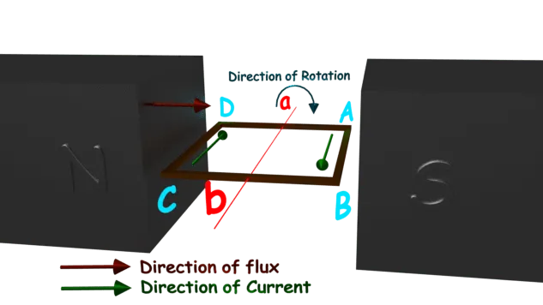
When the loop rotates from its vertical position to its horizontal position, it cuts the flux lines of the field.
As during this movement two sides, i.e., AB and CD of the loop cut the flux lines there will be an EMF induced in both of the sides (AB and BC) of the loop.
As the loop gets closed there will be a current circulating through the loop. The direction of the current can be determined by Flemming’s right hand Rule.
This rule says that if you stretch the thumb, index finger, and middle finger of your right-hand perpendicular to each other, then thumbs indicates the direction of motion of the conductor, index finger indicates the direction of the magnetic field, i.e., N – pole to S – pole, and middle finger indicates the direction of flow of current through the conductor.

Slide 7
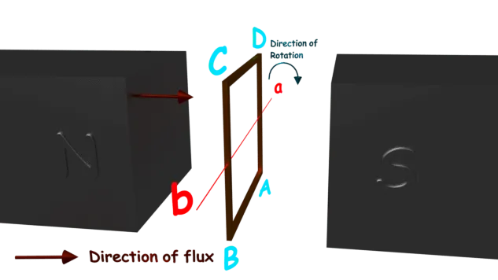
Now if we apply this right-hand rule, we will see at this horizontal position of the loop, current will flow from point A to B and on the other side of the loop, the current will flow from point C to D.
Now if we allow the loop to move further, it will come again to its vertical position, but now the upper side of the loop will be CD, and the lower side will be AB (just opposite of the previous vertical position).
At this position, the tangential motion of the sides of the loop is parallel to the flux lines of the field. Hence there will be no question of flux cutting, and consequently, there will be no current in the loop.

Slide 8
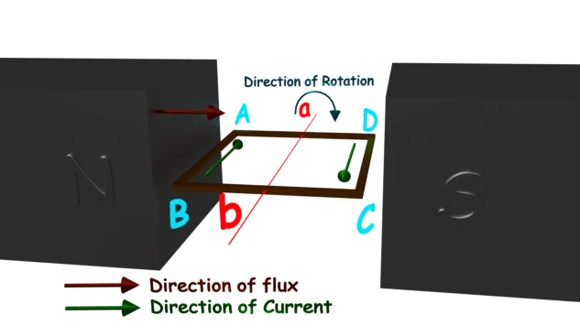
If the loop rotates further, it comes again in a horizontal position. But now, said AB side of the loop comes in front of N pole, and CD comes in front of S pole, i.e., just opposite to the previous horizontal position as shown in the figure beside
Here the tangential motion of the side of the loop is perpendicular to the flux lines; hence rate of flux cutting is maximum here, and according to Flemming’s right-hand Rule, at this position current flows from B to A and on another side from D to C.
Now if the loop is continued to rotate about its axis. Every time the side AB comes in front of S pole, the current flows from A to B. Again, when it comes in front of N pole, the current flows from B to A.

Slide 9
Similarly, every time the side CD comes in front of the S pole the current flows from C to D. When the side CD comes in front of the N pole the current flows from D to C.
If we observe this phenomenon differently, we can conclude, that each side of the loop comes in front of N pole, the current will flow through that side in the same direction, i.e., downward to the reference plane.
Similarly, each side of the loop comes in front of the S pole, the current through it flows in the same direction, i.e., upwards from the reference plane. From this, we will come to the topic of the principle of DC generator.
Now the loop is opened and connected with a split ring as shown in the figure below. Splitrings, made of a conducting cylinder, get cut into two halves or segments insulated from each other.
We connect the external load terminals with two carbon brushes which rest on these splitslip ring segments

Slide 14
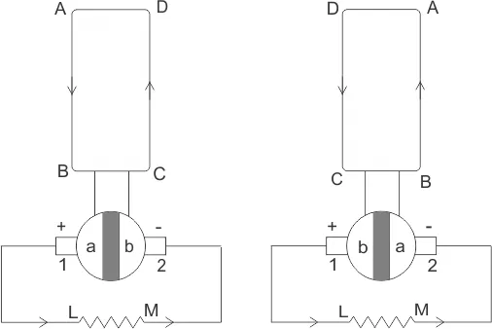
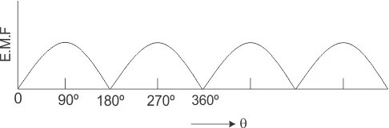
Working Principle of DC Generator
We can see that in the first half of the revolution current always flows along ABLMCD, i.e., brush no 1 in contact with segment a.
In the next half revolution, in the figure, the direction of the induced current in the coil is reversed.
But at the same time the position of segments a and b are also reversed which results that brush no 1 comes in touch with segment b.
Hence, the current in the load resistance again flows from L to M. The waveform of the current through the load circuit is as shown in the figure.
This current is unidirectional.
The above content is the basic working principle of the DC generator, explained by the single loop generator model.

Slide 15
The positions of the brushes of the DC generator are so that the change over of the segments a and b from one brush to another takes place when the plane of the rotating coil is at a right angle to the plane of the lines of force.
It is to become in that position, the induced EMF in the coil is zero.

Slide 16
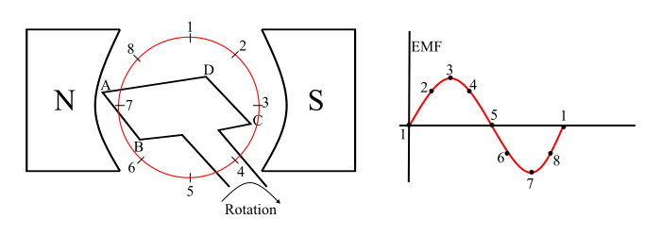
Working of a DC Generator
Consider a single loop DC generator (as shown in the figure), in this a single turn loop ‘ABCD’ is rotating clockwise in a uniform magnetic field with a constant speed.
When the loop rotates, the magnetic flux linking the coil sides ‘AB’ and ‘CD’ changes continuously.
This change in flux linkage induces an EMF in coil sides and the induced EMF in one coil side adds the induced EMF in the other.

Slide 17
The EMF induced in a DC generator can be explained as follows
When the loop is in position-1, the generated EMF is zero because, the movement of coil sides is parallel to the magnetic flux.
When the loop is in position-2, the coil sides are moving at an angle to the magnetic flux and hence, a small EMF is generated.
When the loop is in position-3, the coil sides are moving at right angle to the magnetic flux, therefore the generated EMF is maximum.
When the loop is in position-4, the coil sides are cutting the magnetic flux at an angle, thus a reduced EMF is generated in the coil sides.
When the loop is in position-5, no flux linkage with the coil side and are moving parallel to the magnetic flux. Therefore, no EMF is generated in the coil.
At the position-6, the coil sides move under a pole of opposite polarity and hence the polarity of generated EMF is reversed. The maximum EMF will generate in this direction at position-7 and zero when at position-1. This cycle repeats with revolution of the coil.

Slide 18
It is clear that the generated EMF in the loop is alternating one.
It is because any coil side (say AB) has EMF in one direction when under the influence of N-pole and in the other direction when under the influence of S-pole.
Hence, when a load is connected across the terminals of the generator, an alternating current will flow through it.
Now, by using a commutator, this alternating emf generated in the loop can be converted into direct voltage.

Slide 19
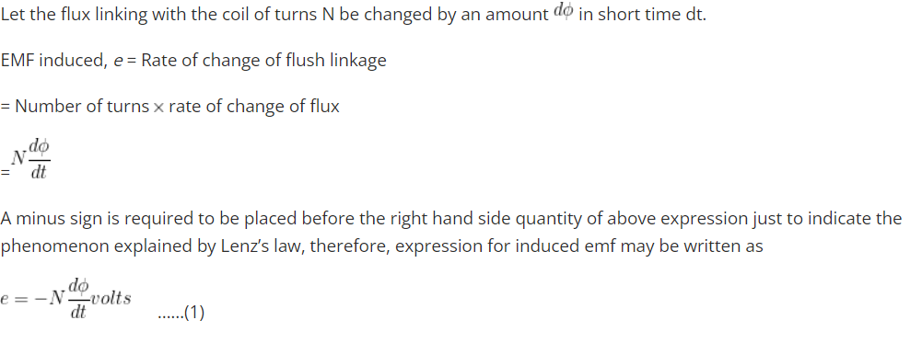
Induced EMF | Statically and Dynamically Induced EMF
Induced e.m.f can be either dynamically induced emf or statically induced emf. in this first case, usually the field is stationary and conductors cut across it (as in d.c. generator).
But in the second case, usually the conductor or the coil remains stationary and flux linked with it is changed by simply increasing or decreasing the current producing this flux (as in transformers).

Slide 20
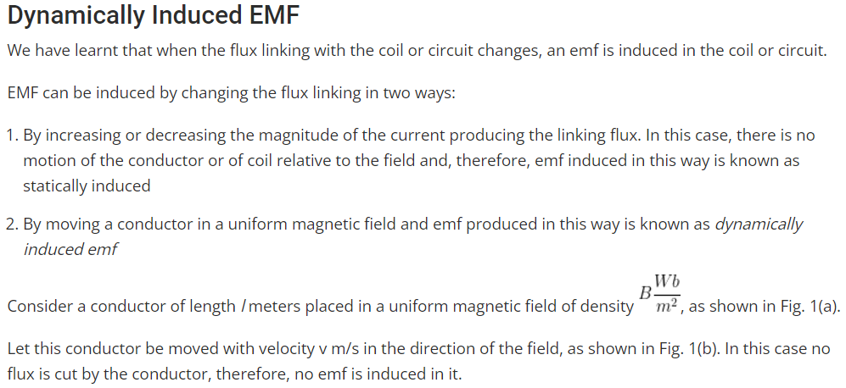

Slide 21
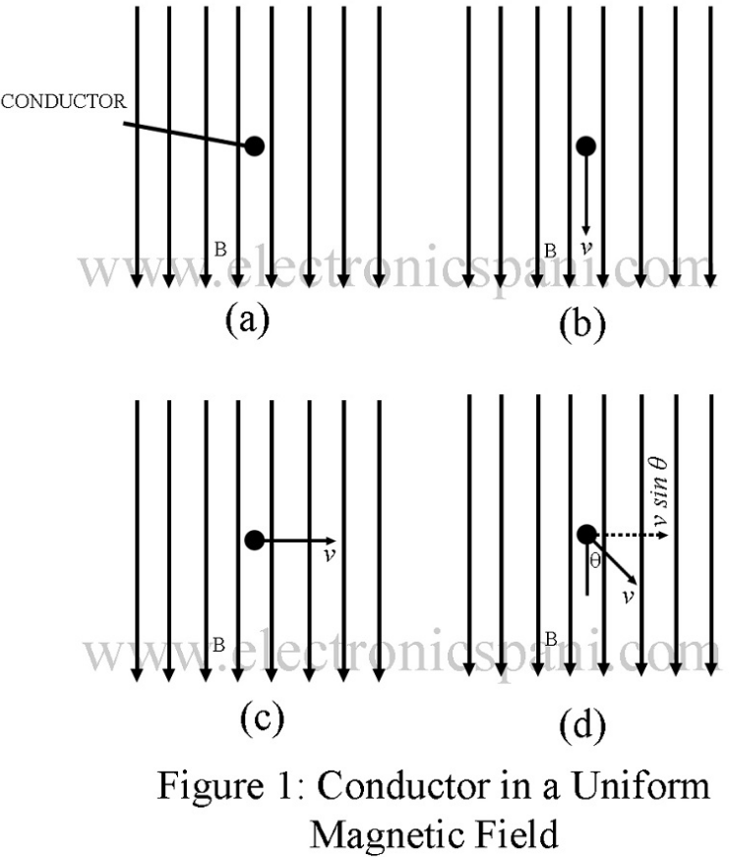

Slide 22
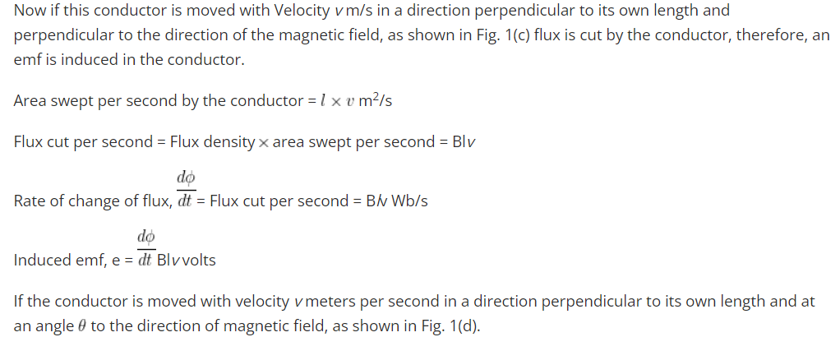

Slide 23
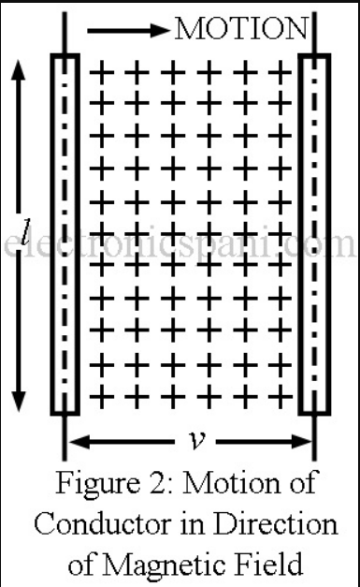

Slide 24
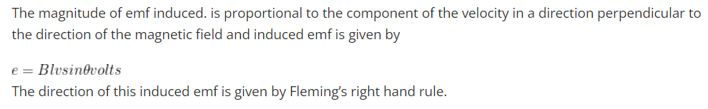
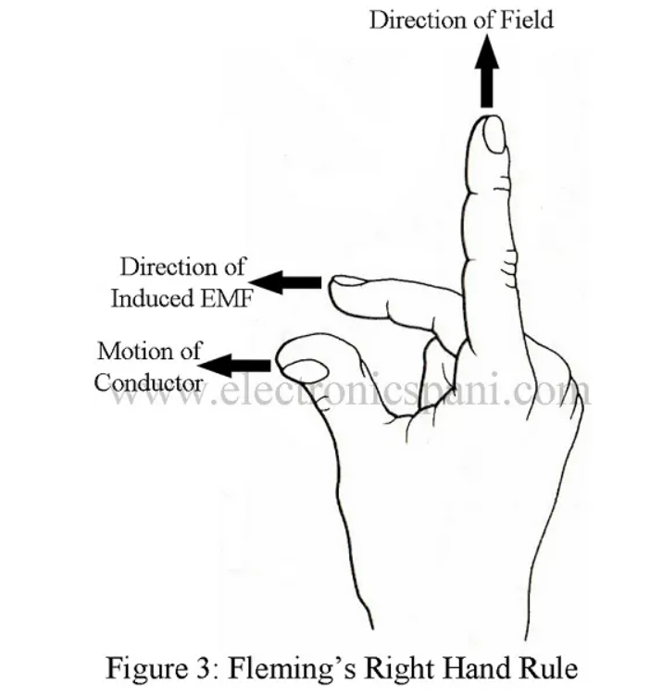

Slide 25
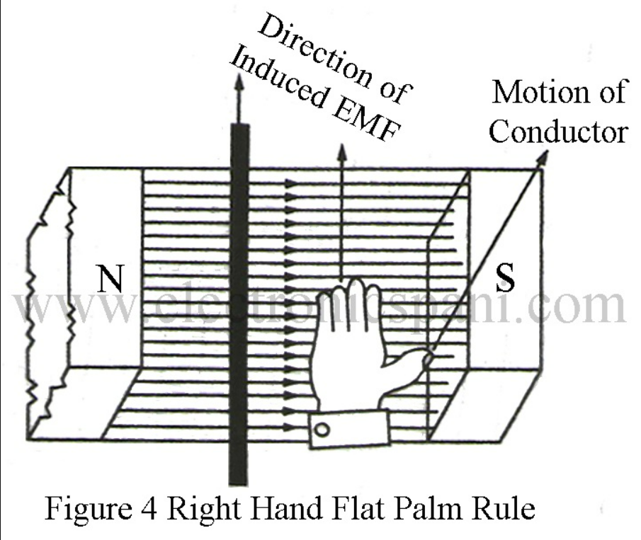
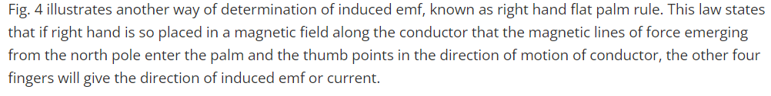

Slide 26
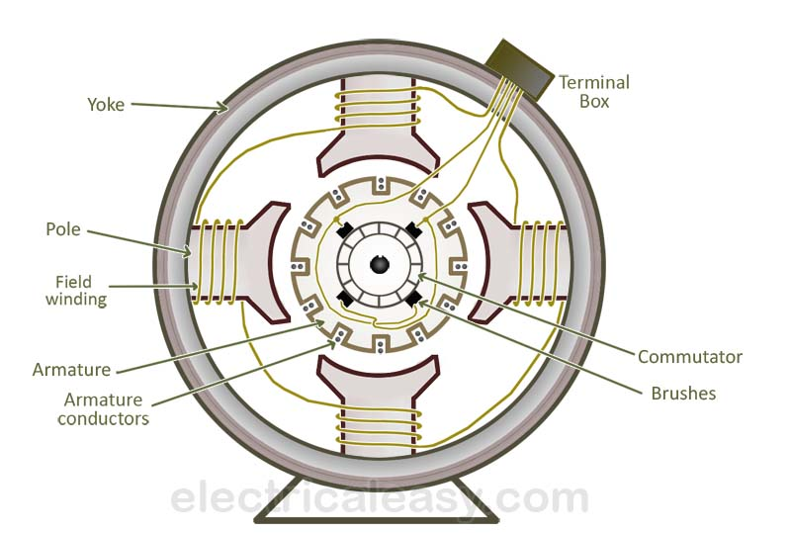
Construction of DC Machine
The DC machine consists of Yoke, Pole, and Pole shoe, Armature core, Field Winding, Armature Winding, Commutator, Brushes, shaft, and Bearings.

Slide 27
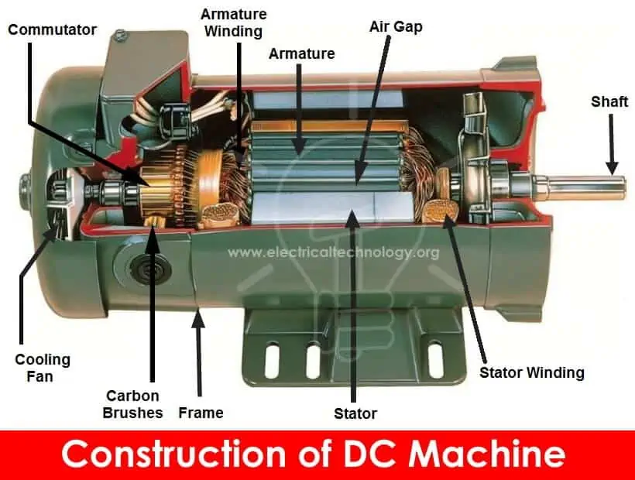

Slide 28
Yoke or Frame
The yoke is also known as the frame. It covers the internal parts of the machine. The yoke is made up of low reluctance magnetic material like iron and silicon steel. Generally, the yoke is made up of iron because iron is cost-effective material than steel.
The yoke is used to provides mechanical protection to the machine. The second application of yoke is that it provides a low reluctance path to the flux. So, flux completes its path through the yoke.
Pole and Pole shoe
The field winding is placed on a pole. When current passes through the field winding, it will create an electric magnetic field and behaves as an electromagnet. The pole shoes expand flux in the entire machine.
To reduce the eddy current losses, the pole and pole shoes are laminated. For a small machine, the pole is not necessary to laminate. It is made up of thin cast steel.
The pole is used to provide housing for the field winding and produce magnetic flux inside the machine. The pole shoes are used to provide support to the field winding and not to slip from the pole.

Slide 29
(OR)
Yoke
The outer frame of a DC generator is a hollow cylinder made up of cast steel or rolled steel is known as yoke. The yoke serves following two purposes
It supports the field pole core and acts as a protecting cover to the machine.
It provides a path for the magnetic flux produced by the field winding.
Magnetic Field System
The magnetic field system of a DC generator is the stationary part of the machine. It produces the main magnetic flux in the generator. It consists of an even number of pole cores bolted to the yoke and field winding wound around the pole core. The field system of DC generator has salient poles i.e. the poles project inwards and each pole core has a pole shoe having a curved surface. The pole shoe serves two purposes
It provides support to the field coils.
It reduces the reluctance of magnetic circuit by increasing the cross-sectional area of it.
The pole cores are made of thin laminations of sheet steel which are insulated from each other to reduce the eddy current loss. The field coils are connected in series with one another such that when the current flows through the coils, alternate north and south poles are produced in the direction of rotation.

Slide 30
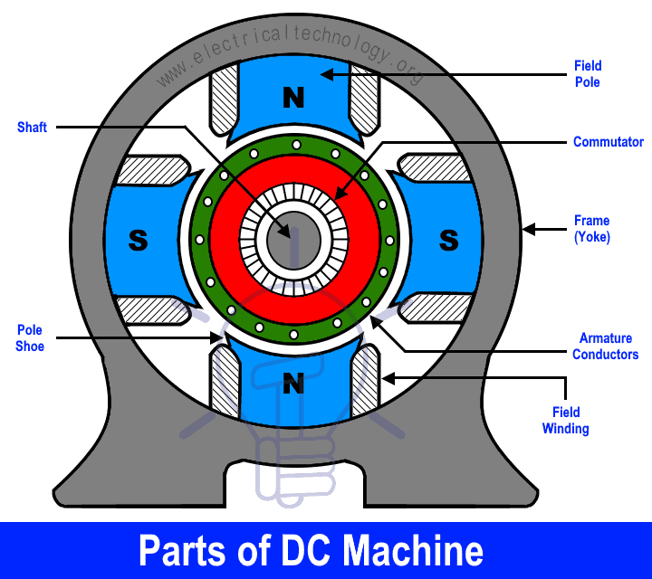

Slide 31
Field Winding
It is winding wounded on the pole is known as the field winding. External DC source or the output of the machine is used to excite the field winding.
It is made up of copper and aluminum. In most of the case, the winding is made up of copper but when the cost is a consideration, aluminum is used.
When DC current passes through the coil, it will generate the electromagnetic field (EMF). And it will magnetize the pole and produce the magnetic flux. The flux produced by the pole is directly proportional to the field current. And flux is more enough to cross the air gap between armature and pole shoes.
Armature Core
The armature core is cylindrical in shape and connected by a key with the shaft. So, it is a rotating part of the DC machine.
The armature core consists of a number of slots on its outer periphery. It is made up of low reluctance and high permeability material like cast iron or cast steel. The armature core is laminated to reduce the eddy current.
The holes are provided on the armature core to release the heat of the machine. The armature slots are used to house the armature winding.

Slide 32
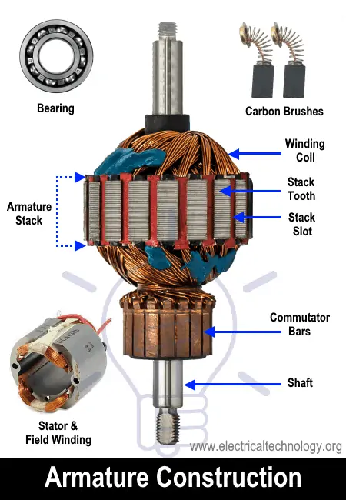

Slide 33
Armature Winding
The armature winding is placed on the slots of the armature core. It is made up of copper. The armature winding links with the magnetic flux and induce a rotating magnetic flux.
According to the connections, there are two types of windings; Lap winding and Wave winding
Lap winding
In lap winding, the armature conductors are divided into groups of a number of poles P. All conductor groups are connected in parallel and in one group, all conductors are connected in series.
For lap winding, the number of a parallel path (A) is the same as the number of poles (P). Therefore, in lap winding, the number of parallel paths is more. And due to this, it is capable of supplying larger load current.
So, lap winding is used for low voltage high current applications.
Wave Winding
In wave winding, all conductors are connected in series and it forms a single loop. For wave winding, irrespective of the number of poles, the number of parallel paths is always two.
So, in wave winding, a smaller number of parallel paths available compared to the lap winding. The wave winding is used for high voltage low current DC machine.

Slide 34
Commutator
The commutator is mounted on the shaft of a machine. The armature conductors are rotating. The commutator is used to connects the rotating armature conductor with a stationary external circuit.
It converts alternating torque produced in the armature into unidirectional torque. In other words, it converts AC torque into DC torque. So, it works similar to the rectifier.
It is made up of a number of segments of hard drawn copper to reduce tear and were. Because it connects the rotating part to a stationary part. All segments are insulated from each other by the thin layer of mica, paper or plastic insulators.
Brushes
The commutator connected the external circuit via brushes. The brushes are used to carry current from the armature conductors.
In most of the cases, brushes are made up of carbon for a small machine and electro-graphite brushes used for the large machines.
The brushes are held the surface of the commutator by springs and rectangular in shape.

Slide 35
Shaft
The shaft used to transfer mechanical power. If the machine is used as a DC motor, mechanical power is transferred from the motor to load. And if the machine is used as a DC generator, mechanical power is transferred from prime mover to the machine.
Bearing
The bearings are used at the end of the shaft. The friction between the rotating part and the stationary part is reduced with the help of bearings.
The bearing is made up of any hard material like carbon steel. The ball type or roll type barring is used in the DC machine.

Slide 36
Emf Equation of a DC Generator
As the armature rotates, a voltage is generated in its coils. In the case of a generator, the emf of rotation is called the Generated emf or Armature emf and is denoted as Er = Eg.
In the case of a motor, the emf of rotation is known as Back emf or Counter emf and represented as Er = Eb.
The expression for emf is same for both the operations, i.e., for Generator as well as for Motor.

Slide 37
Derivation of EMF Equation of a DC Machine – Generator and Motor
Let,
P – number of poles of the machine
ϕ – Flux per pole in Weber.
Z – Total number of armature conductors.
N – Speed of armature in revolution per minute (r.p.m).
A – number of parallel paths in the armature winding.

Slide 38
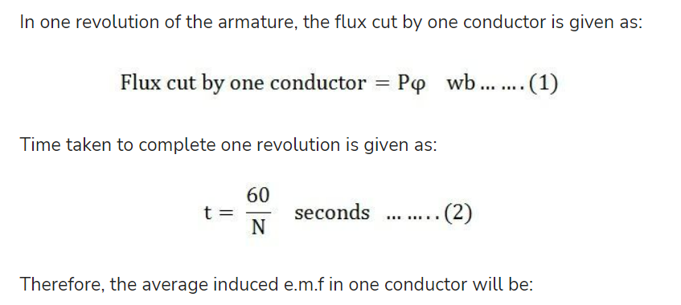

Slide 39
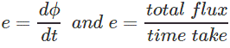
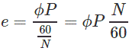
Where, N = speed of the armature conductor in rpm. Now, according to Faraday’s law of induction, the induced emf of the armature conductor is denoted by “e” which is equal to rate of cutting the flux.
Therefore,
Induced emf of one conductor is

Slide 40
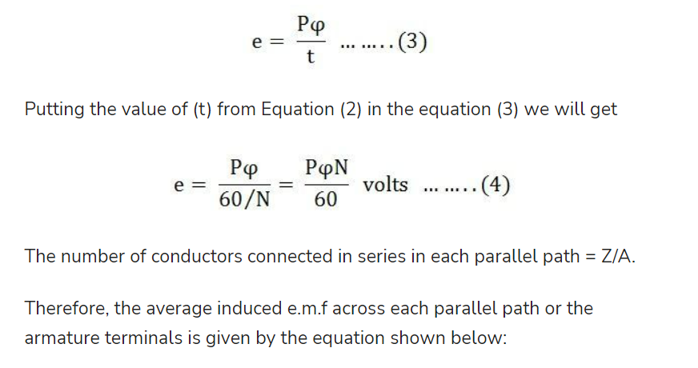

Slide 41
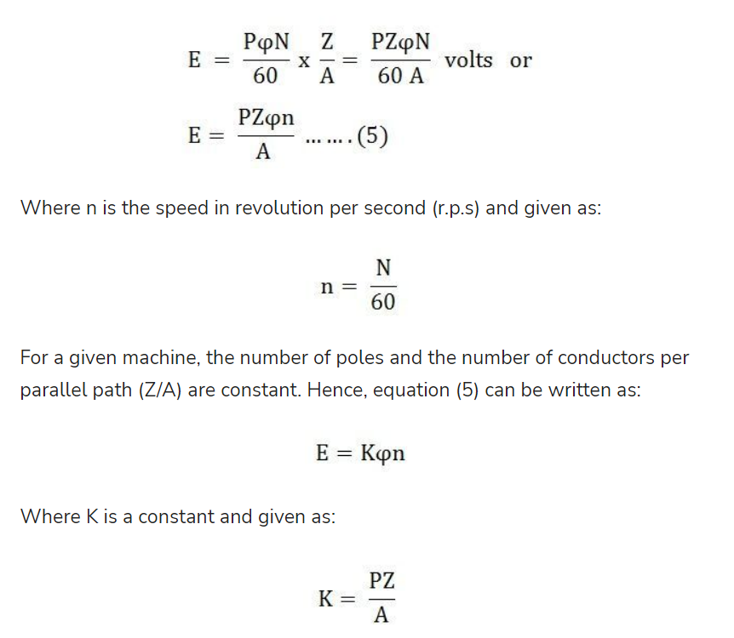

Slide 42
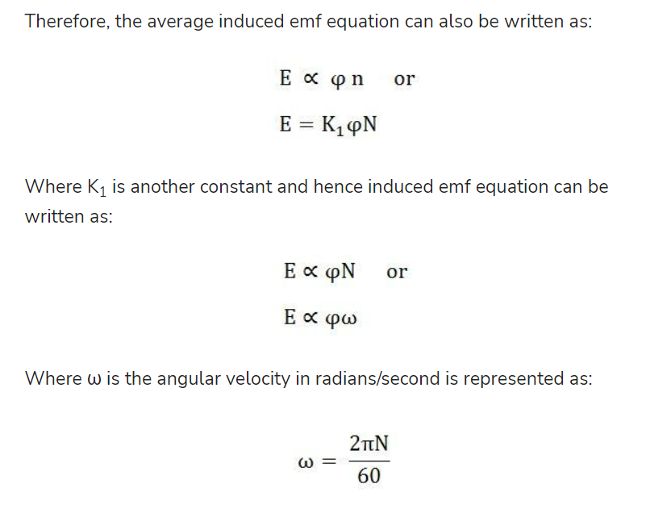

Slide 43
Thus, it is clear that the induced emf is directly proportional to the speed and flux per pole.
The polarity of induced emf depends upon the direction of the magnetic field and the direction of rotation.
If either of the two is reversed the polarity changes, but if two are reversed the polarity remains unchanged.
This induced emf is a fundamental phenomenon for all the DC Machines whether they are working as a generator or motor.
If the DC Machine is working as a Generator, the induced emf is given by the equation shown below:

Slide 44
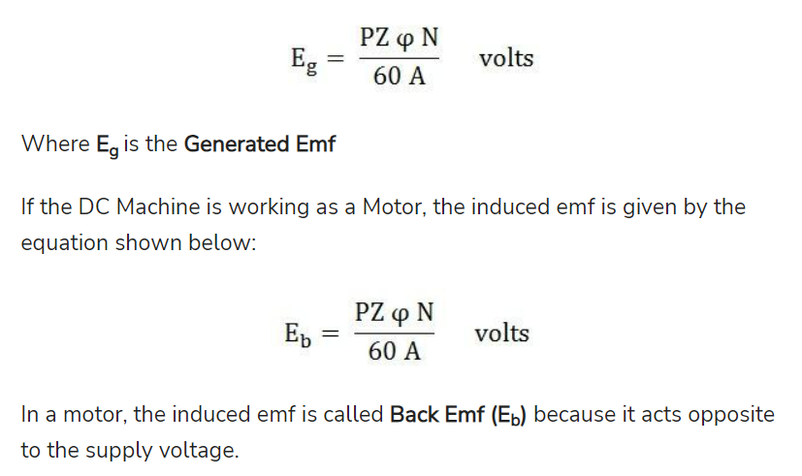

Slide 45
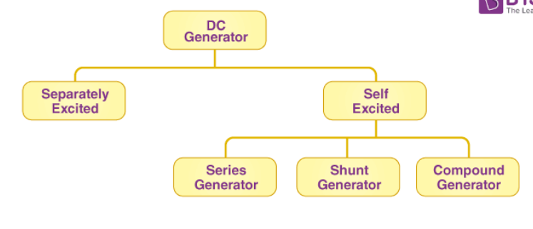
Types of DC generator
The DC generator can be classified into two main categories as separately excited and self-excited.

Slide 46
Method of Exitation
The magnetic field required for the operation of a d.c generator is produced by an electromagnet.
This electromagnets carries a field winding which produces required magnetic flux when current is passed through it.
Note:The field winding is also called exciting winding &current carried by the field winding an exciting current.
*Thus supplying current to the field winding is called “Excitation”*. &the way of supplying the excitating current is called method of excitation.

Slide 47
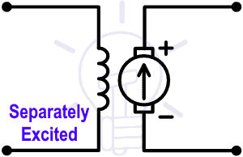
Classification of DC Machine
There are different types of DC machines like series, shunt, short shunt compound and long shunt compound.
According to the field excitation method, the DC machines are classified as;
Separately Excited DC Machine
Self-Excited DC Machine
Separately Excited DC Machine
In this type of machine, the field winding is electrically separate from the armature winding. There is no physical connection between the field winding and the armature winding.
In separately excited machines, the field winding is supplied from a separate power source.

Slide 48
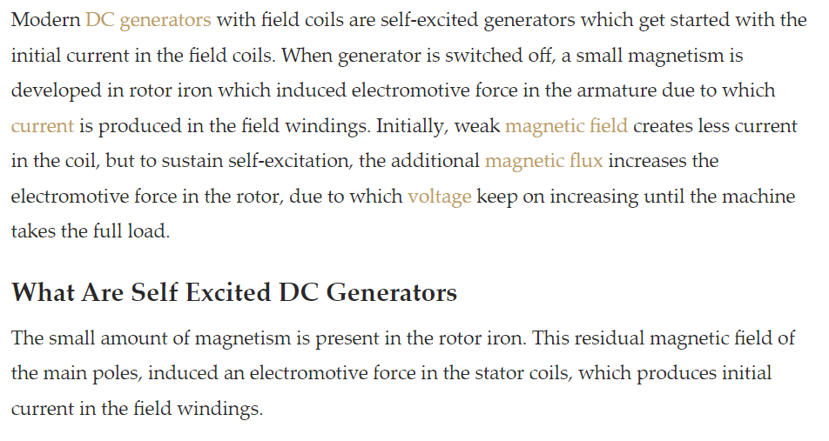
Self Excited Generator

Slide 49
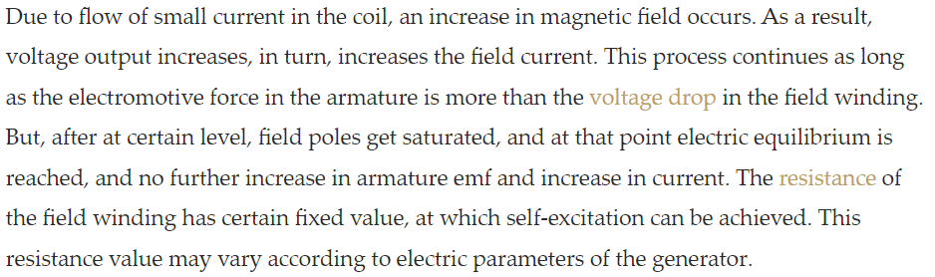

Slide 50
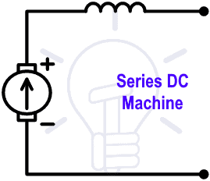
Self-excited DC Machine
In this type of DC machine, the field winding and armature winding are connected with each other. The performance characteristic of a machine depends on the connection between the field winding and armature winding.
According to the connection between field winding and armature winding, the DC machines are classified as;
Series Wound DC Machine
Shunt Wound DC Machine
Compound Wound DC Machine
Series DC Machine
In this type of DC machine, the field winding is connected in series with the armature winding. Because of the series connection, the entire load current (armature current) will pass from the field winding. And this current is high.
So, the series field winding is designed with a smaller number of turns of thick wire to reduce the resistance.

Slide 51
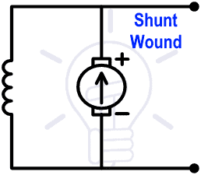
Shunt Wound DC Machine
In this type of DC machine, the field winding is connected in parallel with the armature winding. Because of the parallel connection, full voltage is applied to the field winding.
Therefore, shunt winding is designed with a large number of turns with high resistance.
The current flow through the field winding is very small. It is just 5% of the rated armature current.

Slide 52
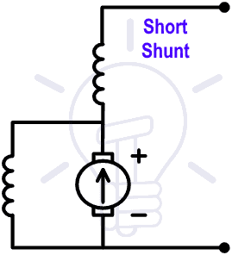
Compound Wound DC Machine
In this type of DC machine, two field windings are used. One winding is connected in series and second winding is connected in parallel with the armature winding.
The compound Wound DC Machine is also classified into two types;
Short Shunt
Long Shunt
Short Shunt
If the field winding is connected in parallel with only the armature winding, the machine is called a Short shunt compound wound DC machine.

Slide 53
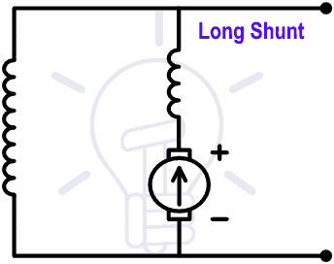
Long Shunt
If the field winding is connected parallel with a combination of series field winding and armature winding, the machine is called a Long-shunt compound wound DC Machine.

Slide 54
Applications of DC Machines
The use of electrical energy increases day by day. And because of that, the use of electrical machines is also increasing.
Generally, the DC machines are used in supplying excitation of an alternator and it is also used in many applications like welding process, variable-speed motor drives and electrolytic and electroplating process.
Small DC machines are used as a control device such as speed sensing, positioning, and tracking.
Application of DC Machine as a Motor
The DC motors are divided into three types; Series motor, Shunt motor, and Compound motor.

Slide 55
Application of DC Machine as Generator
The DC generators are classified as Separately excited DC generator, Shunt-wound, and Series-Wound generator.
Separately excited DC Generator
This type of DC generator is used for testing in laboratories. Because it has a wide range of voltage input. It is also used as a supply to DC motor.
Shunt-wound Generator
This type of generator used to charge a battery and provide excitation to the alternator. This type of generator also used for lighting purposes.
Series-wound Generator
Series-wound generators are used in locomotive for providing fie

Slide 56
DC MOTOR
Working Principle of a DC Motor
The DC motor is the device which converts the direct current into the mechanical work. It works on the principle of Lorentz Law, which states that “the current-carrying conductor placed in a magnetic and electric field experience a force”.
The experienced force is called the Lorentz force. The Flemming left-hand rule gives the direction of the force.
Fleming Left Hand Rule
If the thumb, middle finger and the index finger of the left hand are displaced from each other by an angle of 90°, the middle finger represents the direction of the magnetic field. The index finger represents the direction of the current, and the thumb shows the direction of forces acting on the conductor.

Slide 57
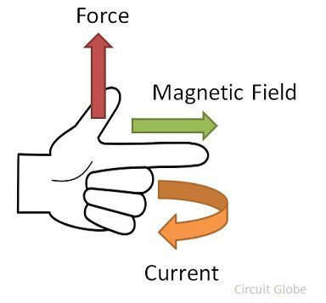
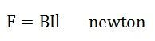
The formula calculates the magnitude of the force,
Before understanding the working of DC motor, first, we have to know about its construction. The armature and stator are the two main parts of the DC motor.
The armature is the rotating part, and the stator is their stationary part. The armature coil is connected to the DC supply.
The armature coil consists the commutators and brushes.
The commutators convert the AC induced in the armature into DC and the brushes transfer the current from rotating part of the motor to the stationary external load.
The armature is placed between the north and south pole of the permanent or electromagnet.

Slide 58
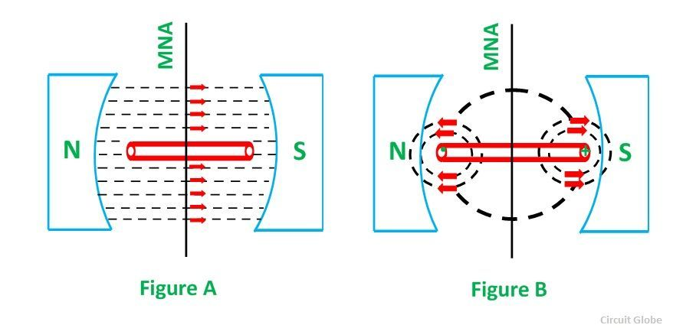
For simplicity, consider that the armature has only one coil which is placed between the magnetic field shown below in the figure A.
When the DC supply is given to the armature coil the current starts flowing through it. This current develops its own field around the coil.
Figure B shows the field induces around the coil:
By the interaction of the fields (produced by the coil and the magnet), the resultant field develops across the conductor.
The resultant field tends to regain its original position, i.e. in the axis of the main field. The field exerts the force at the ends of the conductor, and thus the coil starts rotating.

Slide 59
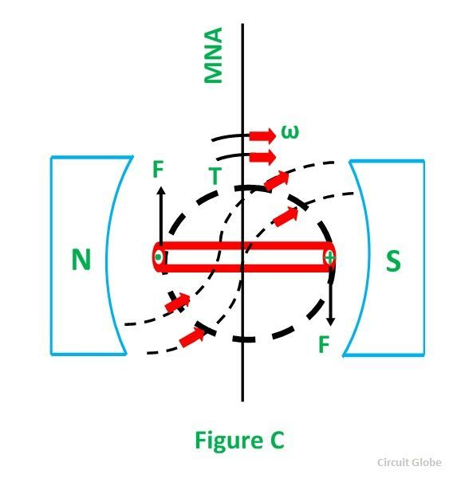
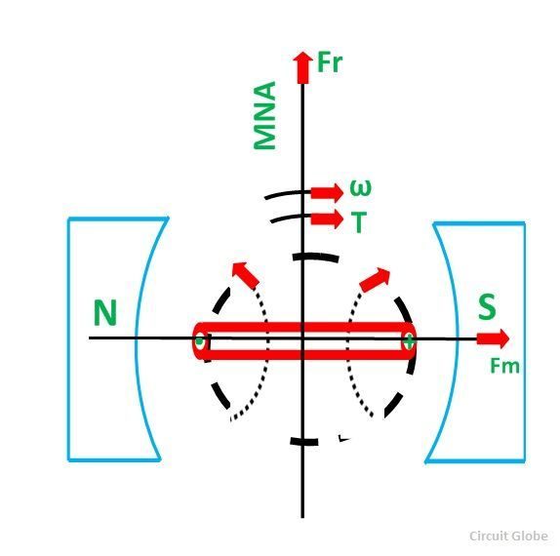
Let the field produced by the main field be F_{m}, and this field rotates in the clockwise direction.
When the current flows in the coil, they produce their own magnetic field say, F_{r}.
The field F_{r} tries to come in the direction of the main field. Thereby, the torque act on the armature coil.

Slide 60
The actual DC motor consists of a large number of armature coils. The speed of the motor is directly proportional to the number of coils used in the motor. These coils are kept under the impact of the magnetic field.
The one end of the conductors is kept under the influence of the north pole, and the other end is kept under the influence of the south pole.
The current enters into the armature coil through the north pole and move outwards through the south pole.
When the coil moves from one brush to another, at the same time the polarity of the coil also changes. Thus, the direction of the force or torque acting on the coil remains the same.
The torque induces in the coil become zero when the armature coil is perpendicular to the main field. The zero torque means the motor stops rotating.
For solving this problem, the number of armature coil is used in the rotor. So, if one of their coils is perpendicular to the field, then the other coils induce the torque.
And the rotor moves continuously.

Slide 61
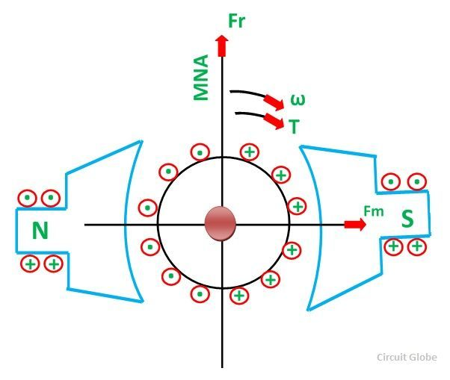
Also, for obtaining the continuous torque, the arrangement is kept in such a way that whenever the coils cut the magnetic neutral axis of the magnet the direction of current in the coils become reversed. This can be done with the help of the commutator.

Slide 62
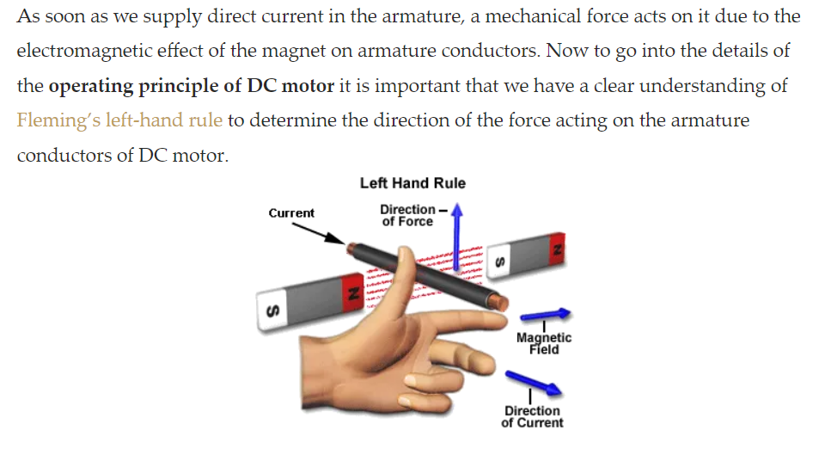
Working or Operating Principle of DC Motor

Slide 63
If a current carrying conductor is placed in a magnetic field perpendicularly, then the conductor experiences a force in the direction mutually perpendicular to both the direction of field and the current carrying conductor.
Fleming’s Left-Hand Rule can determine the direction of rotation of the motor.
This rule says if we extend the index finger, middle finger and thumb of our left-hand perpendicular to each is such a way that middle finger is in the direction of current in the conductor, and index finger is along the direction of magnetic field, i.e., north to south pole, then thumb indicates the direction of the created mechanical force.

Slide 64
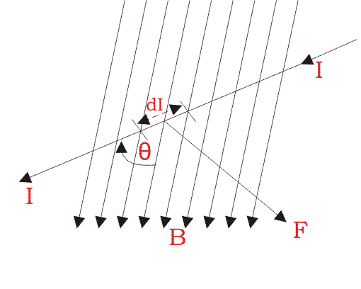
For clear understanding the principle of DC motor we have to determine the magnitude of the force, by considering the diagram below.

Slide 65
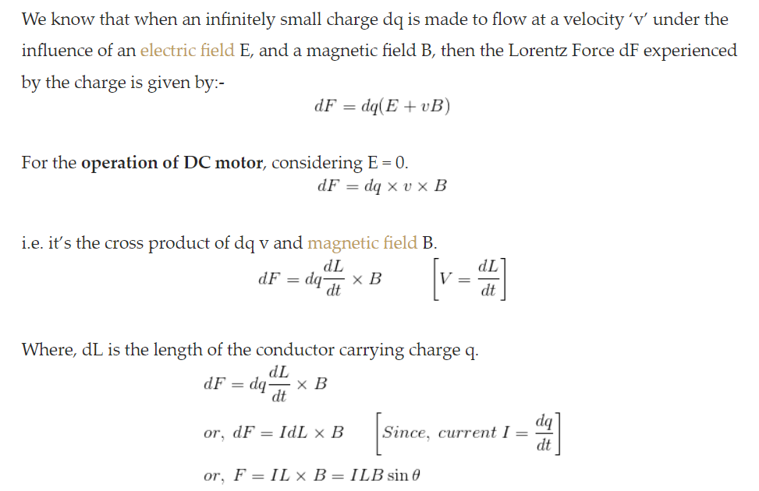


Slide 66
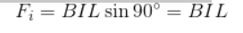
From the 1st diagram we can see that the construction of a DC motor is such that the direction of current through the armature conductor at all instance is perpendicular to the field.
Hence the force acts on the armature conductor in the direction perpendicular to both uniform field, and current is constant.
So if we take the current in the left-hand side of the armature conductor to be I, and current at the right-hand side of the armature conductor to be -I, because they are flowing in the opposite direction to each other.
Then the force on the left-hand side armature conductor,
Similarly, the force on the right-hand side conductor,

Slide 67
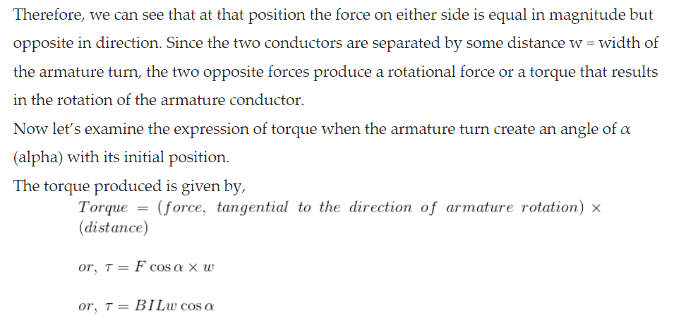

Slide 68
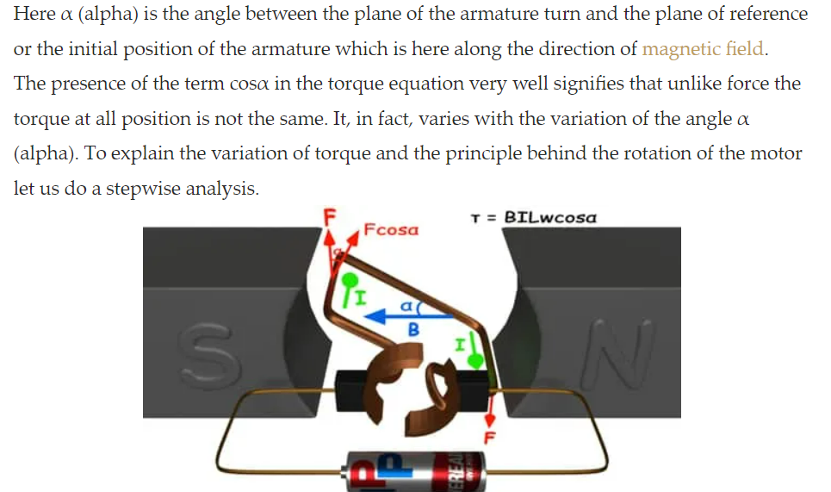

Slide 69
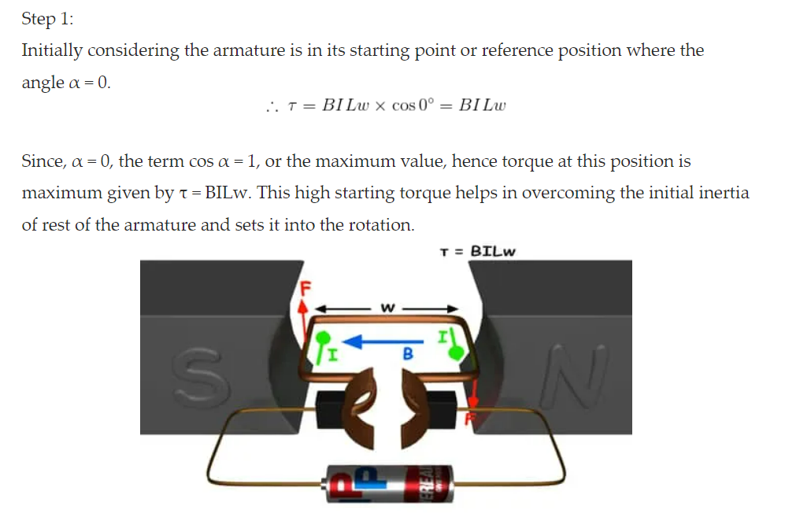

Slide 70
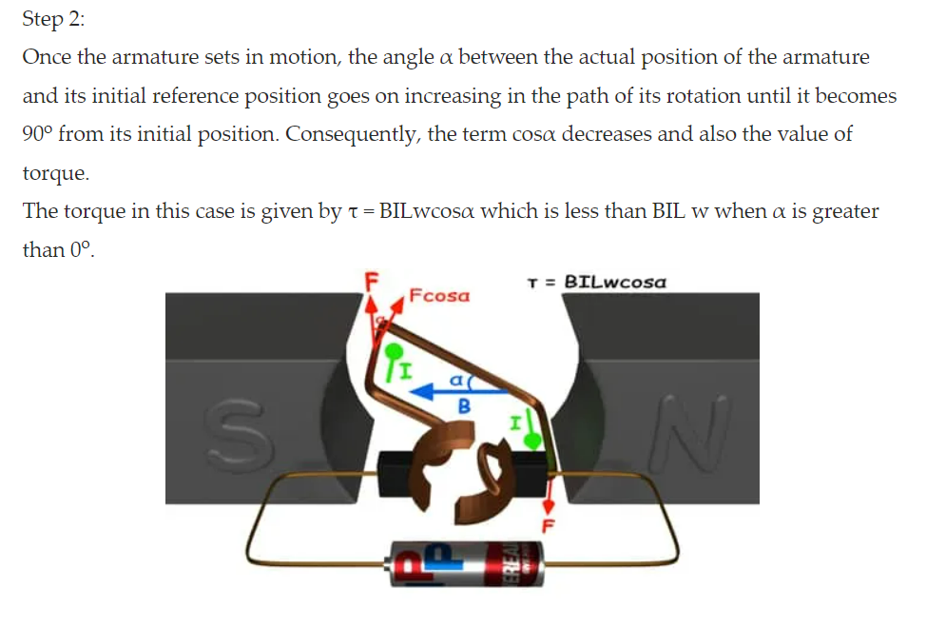

Slide 71
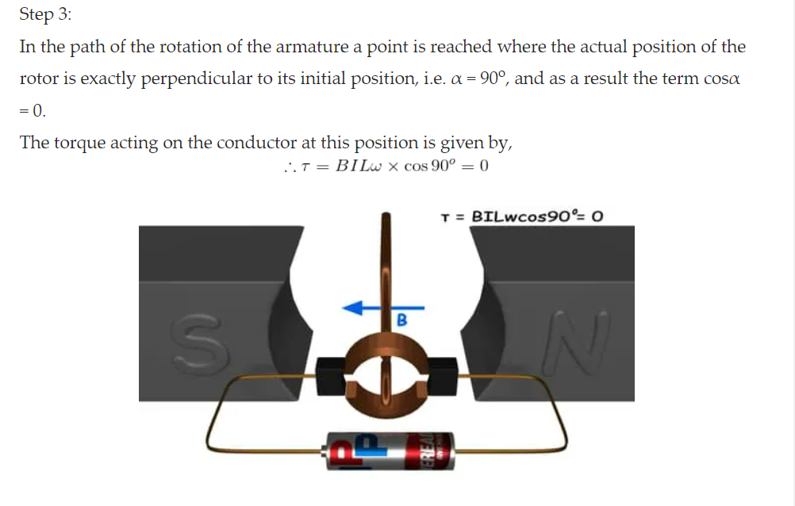

Slide 72


Slide 73
Series Motor
The series motors are used in the application where high starting torque is necessary and speed variation is possible.
Example- Vacuum cleaner, Air Compressor, Cranes, Traction system, etc.
Shunt Motor
The shunt motor is used in the application where starting torque is not needed more and running on the constant speed.
Example- conveyer, Lift, Fans, Lathe machine, Spinning machine, centrifugal pump, etc.
Compound Motor
The compound motors are used in applications where higher starting with constant speed is required.
Examples- Rolling mills, Elevators, Conveyer, Presses, etc.

Slide 74
Types of DC Generators
DC generators are classified based on how their fields are excited (i.e. produced).
There are three methods of excitation, and thus three main types of DC generators:
Permanent Magnet DC Generators – Field coils excited by permanent magnets
Separately Excited DC Generators – Field coils excited by some external source
Self Excited DC Generators – Field coils excited by the generator itself
Self-excited DC generators can further be classified depending on the position of their field coils. The three types of self-excited DC generators are:
Series Wound Generators
Shunt Wound Generators
Compound Wound Generators

Slide 75

A portable generator is an example of a practical application that utilises such technologies.
Permanent Magnet DC Generator
When the flux in the magnetic circuit is created through the use of permanent magnets, then it is known as a Permanent magnet DC generator.
It consists of an armature and one or several permanent magnets situated around the armature. This type of DC generator generates does not generate much power.
As such they are rarely found in industrial applications. They are normally used in small applications – like dynamos in motorcycles.

Slide 76
Separately Excited DC Generator
These are the generators whose field magnets are energized by some external DC source, such as a battery.
A circuit diagram of separately excited DC generator is shown in the figure below. The symbols below are:
I_{a} = Armature current
I_{L} = Load current
V = Terminal voltage
E_{g} = Generated EMF (Electromagnetic Force)

